Slide 1
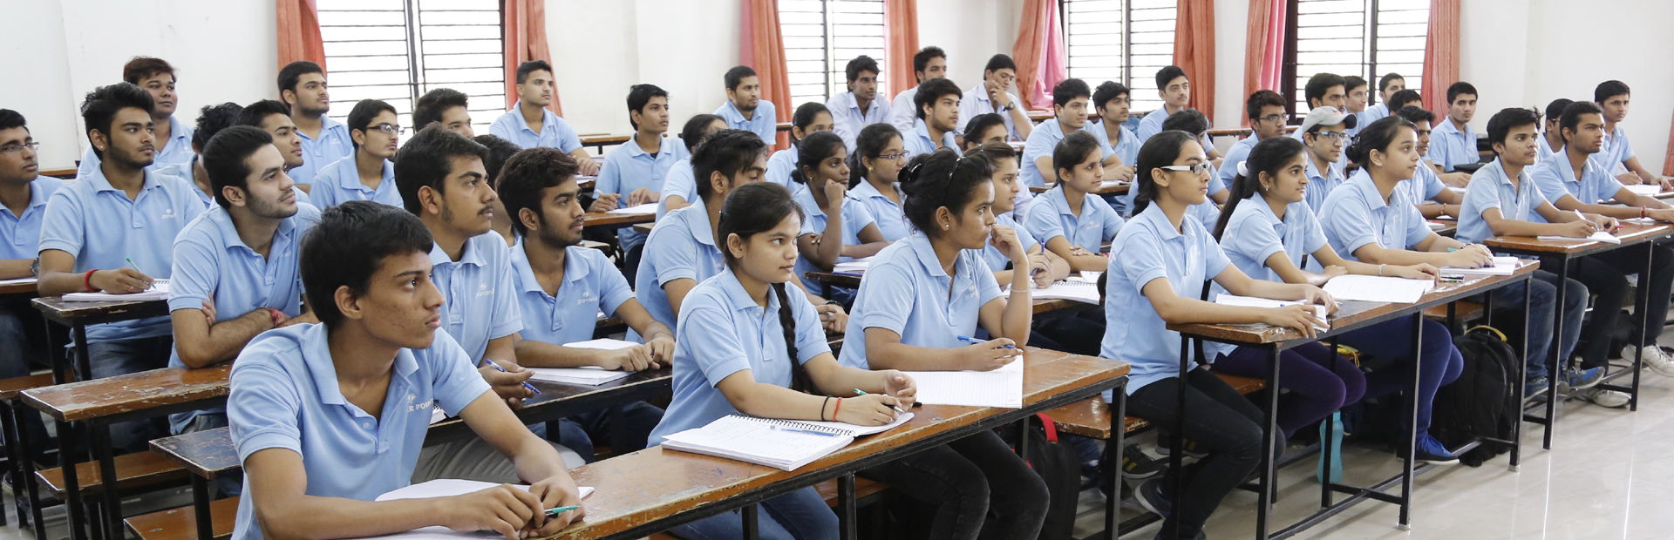

Turnkey Solutions for Engineering & Medical Entrance Exams in India (IIT-JEE / NEET (UG)
Unisys Guide 2017-18
For Classroom Year long Program
Target: JEE ( Main + Advance) I JEE ( Main)
NEET ( UG)-AIPMT I AIIMS

Slide 2



Welcome to Kota
City of Education known for IIT-JEE / Medical Examination coaching
NEET (UG)
Kota- Best Choice for aspirants of IIT-JEE / NEET (UG)
Kota (Rajasthan) is an educational hub of India, specially for Medical and engineering entrance exam preparation. Kota is also called coaching capital of India which has maintained its winning streak constantly in the IIT-JEE and Medical entrance exam-NEET (UG).

Slide 3
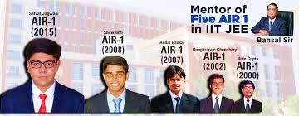
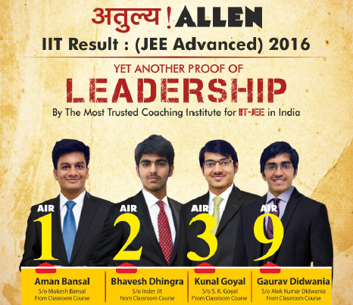
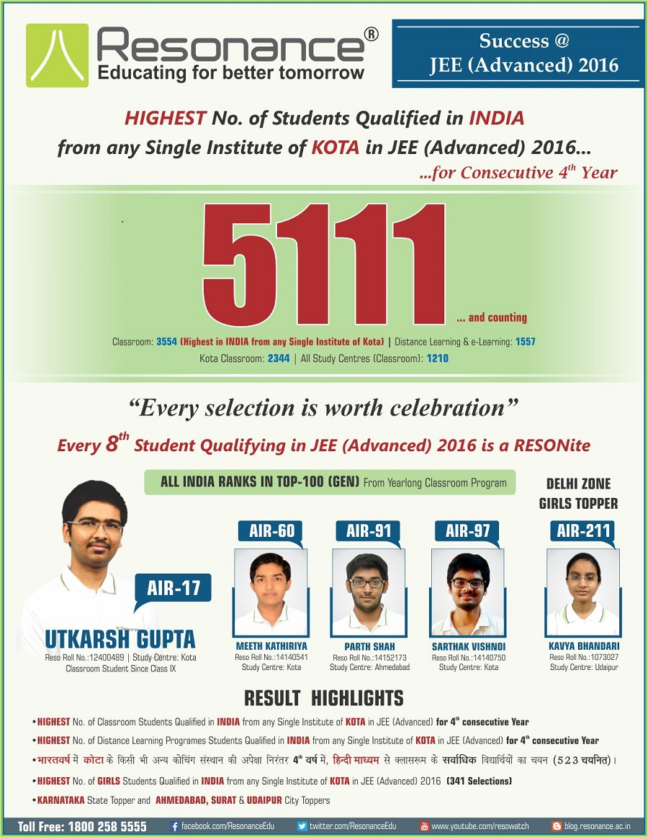
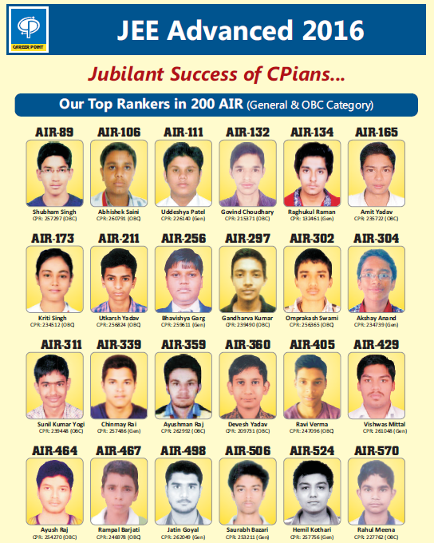
KOTA SECURING
TOP RANKS
Coaching centres of Kota are committed for maintaining exceptionally high standards of learning and therefore seek only the sincere & hard working students for classroom courses. A very high degree of commitment, dedication and strong motivation for success in JEE (Main + Advanced), JEE (Main) & NEET (UG)- AIIMS/ AIPMT is expected from the students.
To compete for the best you need to learn from the best coaching institutions in India and Kota is a proven destination for aspirants of IIT-JEE / Medical entrance examination.

Slide 4
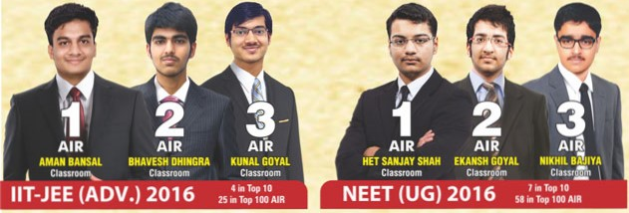

Kota creates history by giving highest number of selection
The first choice across India
The greatest results ever in IIT-JEE ( Advance ) / NEET ( UG ) 2016

Slide 5
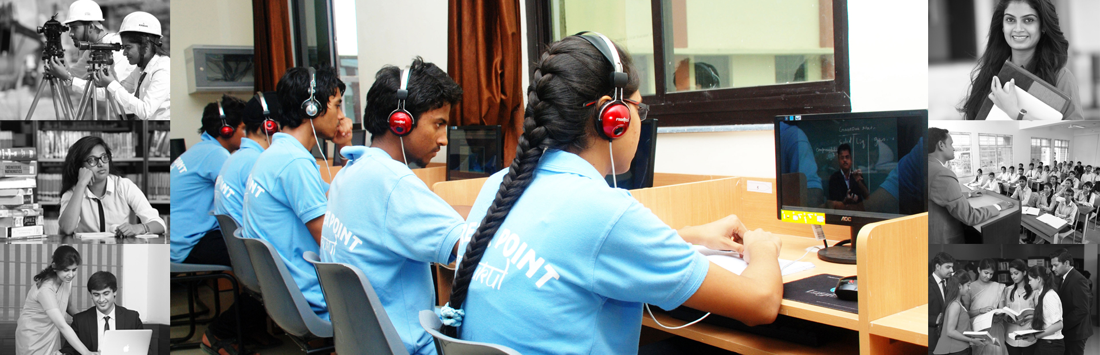
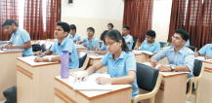
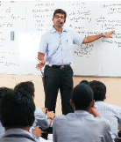
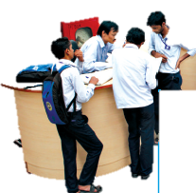



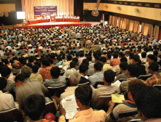
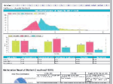

JEE ( Main + Advance) / Pre Medical
IIT-JEE / AIEEE / AIPMT
Teaching Methodology
Individual Doubt clearing counter
Intensive Care Program
Doubt Removal Classes
Counselling and Mentorship
Intelligent Test system
Smart Study Material
Concept Building
Expert Counselling
Online Test Centre
Periodic Test Series
Motivation and Academic Seminar
Performance Feedback

Slide 6

Just finishing class X and now want to get coaching at Kota, Rajasthan, India for Cracking IIT-JEE /AIEEE / AIPMT-NEET (UG) / AIIMS
Which is the best coaching for me ?
How to get admission ?
How about my schooling along with coaching ?
Accommodation, food, commuting ?
Most importantly my safety
and security at unknown place ?
One Answer for your all need is UNISYS

Slide 7
Unisys Education and Research Pvt Ltd
Vision & Mission
Unisys Education and research Pvt Ltd is an organization that is formed with an aim to enhance the current education system for both institutions and students.
This is an ally of Global Research for Excellence in Education Pte Ltd. (GREE), A Singapore based entity.
Unisys was founded by renowned academicians and research scholars of India. It helps students getting admissions in various popular universities and colleges of the world. Unisys also offers NRI students best of the coaching services through a beautifully designed service package for medical and engineering aspirants.
At Unisys, we have the vision of providing best of the learning avenues across the globe.
With best wishes
Team Unisys

Slide 8
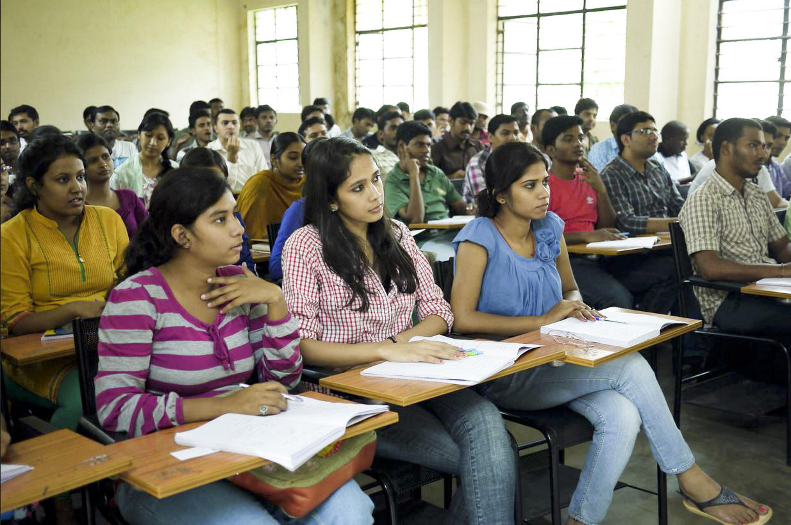

Turnkey Solution for NRI Students at Kota / Rajasthan
Coaching package tailored for NRI students
Unisys – Discover your child’s
Passport to Success with us
Pre-flight boarding documentation- School Transfer certificates & academic credentials along with ID proofs etc.
Travel arrangement to Jaipur – India and Escort from Airport to accommodation at Unisys rooms / Kota
Hostel with food facility
Conveyance facility hostel-coaching-hostel
Admission service into School Integrated Program
- Coaching plus school
24 x 7 Safety and Security of student

Slide 9



Pre-flight boarding documentation: Unisys assists all its students collate the appropriate documents required for getting admission in Coaching plus CBSE School in India as well for other essential things which student may need during travel etc. The list beneath provides an overview of the documents that will be required before you board flight to India as part of a student’s application to study at Kota
School Transfer certificate
X Mark Sheet issued by any one of CBSE / ICSE / SSLC
Indian passport copies for parents and children
Parent’s ID proof
Any other documents if required by law’s
Welcome to second home
Mr Rosh – Dubai
Welcome to Unisys:
Warm welcome by Unisys at Jaipur airport. One welcome kit is given to student, which contains
One post-paid mobile SIM card to use for local communication
Safety & security guidelines to follow
After reaching at Kota at Unisys guest house, detailed orientation is given by Desk manager.

Slide 10
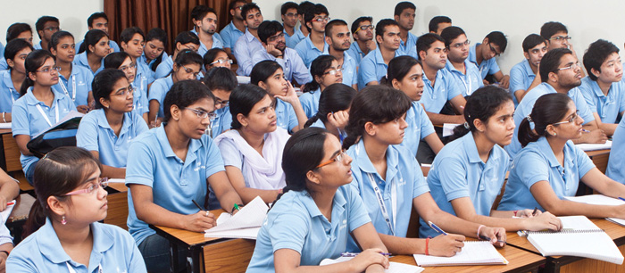
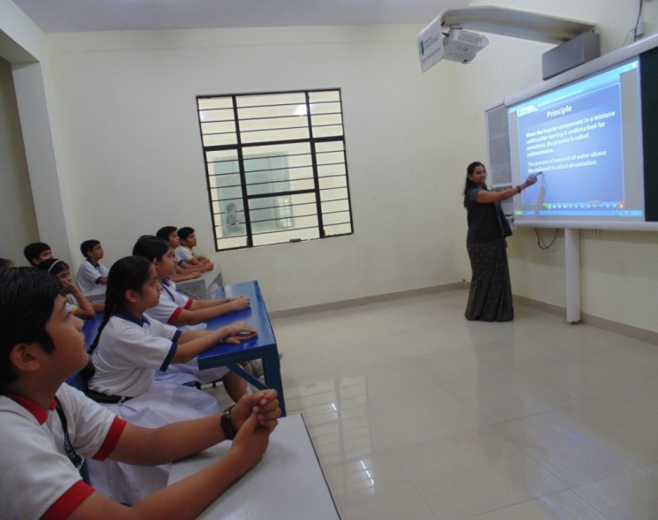
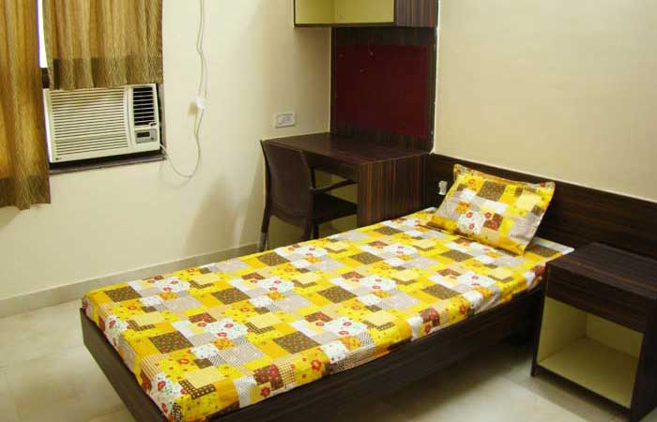
Unisys brings unique solution for a NRI student’s
all need at one place
IIT-JEE (Main + Advance)/NEET(UG) Coaching
CBSE School
Accommodation
Food
IIT-JEE / NEET (UG)
Coaching at best centre
Bansal Classes
Allen Career Institute
Resonance
Career Point
Vibrant Academy
Schooling at School following the CBSE (Central Board of Secondary Education Affiliated) - English Medium
St. Joseph Hitech School
Shiv Jyoti Convent School
Bansal Public School
Lawrence & Mayo Public School
Saint John’s Sen. Sec. School
Homely Stay
AC-Single Bed room
AC- Double bed room
Room design as per 3 star
hotel parameters
Fully air conditioned

Slide 11
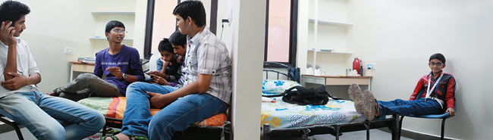
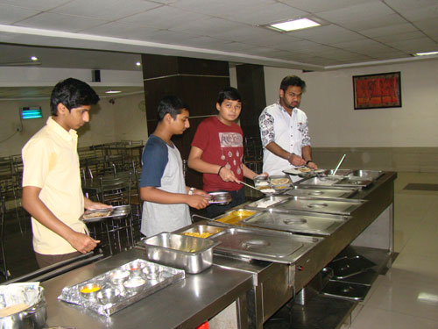
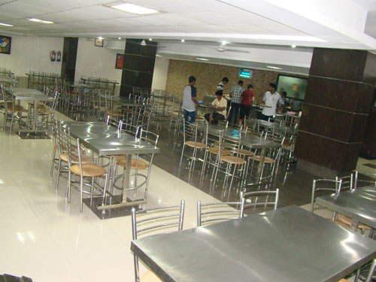
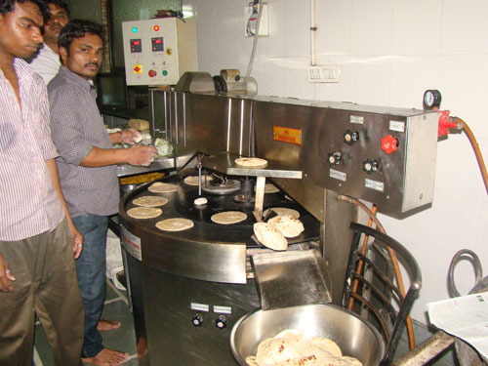
Features:
Adequate security with CCTV cameras and constant vigilance
Departmental store in the premise
Automatic lift with power backup
In-house mess and dining hall providing breakfast, lunch, snacks and dinner
Balanced and nutritious diet using daily fresh vegetables
Less oily and less spicy food
Pure vegetarian food prepared in clean and hygienic facility
RO/UV treated drinking water coolers
Laundry facility
Medical and doctors facility on call
Common areas with magazines, newspapers and recreational facilities
Vehicle arrangement for commuting
Peaceful and disciplined environment
Helpful staff catering to every need of the students
Homely Stay with Unisys

Slide 12
Courses Details
2 Year Course for Class XI Students (English Medium)
Course concept: A Course specially designed for those students who wish to take an early advantage by enrolling immediately after Class-X Board examination.
Target - IIT-JEE ( Main+ Advance) -2019
Eligibility : Class X to XI Moving Students
Course Commencement: First Batch starting from 01 April, 2017
Target- Pre-Medical NEET (UG), AIIMS -2019
Eligibility : Class X to XI Moving Students
Course Commencement: First Batch starting from 01 April, 2017

Slide 13
Fee Structure
Package Fee : All for one year ( XI class )
Coaching Fees, School Fee, Hostel & Mess Fee and Conveyance.
Pick up students & Parents from Jaipur Airport, counseling, Welcome Kit ( Unisys ID card, DO and DON’T Safety and Security guidelines & Local Pre paid mobile 4G SIM), transfer to Kota, two days stay in 3 star hotel at Kota, visit to coaching institute, School and hostel then drop back to Jaipur Airport.
Course | 1st Instalment | 2nd Instalment | Total In USD | On time deposit Benefit In USD
Target- IIT-JEE ( Main+ advance)-2019 Pre Medical / AIIMS-2019 | 5075 | 2375 | 7450 | 7250
*The Total Course Fee includes Service Tax @ 14 % , Swachh Bharat Cess @ 0.5% and Krishi Kalyan Cess @ 0.5% on Tuition Fee. * The Rates of Service Tax is as decided by Govt. of India and is subject to revision. Hence, the rate/amount of Service Tax may increase or decrease in future.

Slide 14
Frequently Asked Questions
1. Why Unisys?
Unisys takes care of students like their own children. We not only provide admission assistance but complete package which is affordable and beneficial to students.
How to enrol for courses through Unisys ?
You need to email filled in application along with all details / required documents (for enrolling you in Coaching, School & Hostel etc.) to nricoaching@unisys.global . All formalities will be done prior to your arrival at Kota, India.
How to pay fees?
You need to pay fee in advance ( 1st Instalment / one time full payment) by transferring amount online in company ‘s account.
If my parents don’t come with me for enrolling me in the course?
You need not to worry. Unisys takes all responsibilities irrespective of your parents accompany you or not. We always send a local guardianship agreement to you before you fly to India. That agreement needs to be signed by your parents. Unisys provide you parental care from end to end. Unisys escort you from your first arrival at Jaipur airport/nearest railway station and then proceed as per our Standard Operating Procedure, which ensure everything is lined up before you fly to India.
Yearlong Unisys guardianship to the students which includes:
  Admission to Coaching Institute and Schools
  Booking best of the hostel with food facility
  Arrangement of daily conveyance
  Arrangement of first travel from nearest airport/Station with accommodation in hotel for two days and visit to schools and institutes for admission.
  Counselling cum orientation with welcome kit with 4G sim card.
  Travel assistance, as and when needed (on cost basis).
  Accommodation related problem handling.
  Coaching institutes related issues.
  Personal counselling, as and when needed.
  Watch on students conduct and performance round the year.
  Ensuring hassle free practical exams, exams and other formalities at school level.
  Assistance in online form filling for IIT/Medical entrance exams.
  Travel and stay arrangements when student goes for IIT/Medical entrance exam (if exam Centre is outside Kota but in Rajasthan) – (On cost basis)
  Medical assistance as when needed. (On cost basis)
  Any other assistance as per the need.
5. Do I need to attend school regularly ?
Whole day is planned in a scientific way to get the best output from student.
Teaching, Self-Study, Working, Doubt removal etc.- everything is done during the day under supervision of the best faculty members leaving very little requirement for self-study at home.
Immediate clarification of doubt for best understanding of fundamentals.
Specially designed Daily Practice Problem Sheets, Exercise sheets, Question Bank & Test Series.
Extra-ordinary personal care and individual focus to enhance accuracy &scoring ability
Healthy & motivating competitive environment. Hence keeping in view the whole teaching methodology its not mandatory for students to attend schools regularly.
We provide both the option.
First option- School and Coaching timing are aligned in such a way that you can attend both in easy way.
Second option- Coaching also provide all major subject tuition in coaching campus itself. Just for practical exercise you need to go school laboratory. For your all commuting to school and coaching, we have our own travel arrangement.
6. How about my safety and security?
Unisys takes Safety & Security on top priority. We keep close watch on every movement of the student. We have our own nodal officer for all kind of issues. Nodal officer and all emergency contact numbers are displayed on Unisys ID card, Which student need to keep with him always. Student can approach nodal officer 24x7 days anytime.
Should you have further detail, please write us or call us at ;
Email to: nricoaching@unisys.global
Ph: +91-141-6556699 I Cell # +91-9950041555 / 7073577706

Slide 15
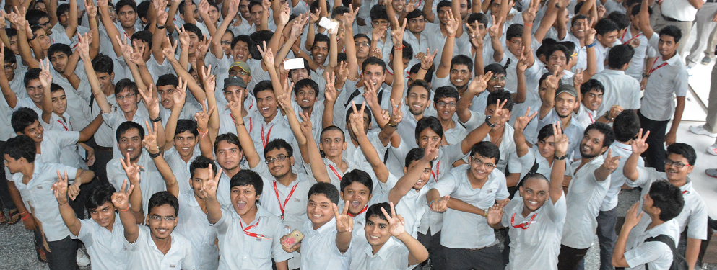
Gateway to IT-JEE / NEET (UG)-Pre Medical Exam
Ensuring Success with Safety
Shaping the lives with parental care
Head Office:
Unisys Educational and Research Pvt Ltd,
622-623, Mansarovar Plaza, Plot No- B, Sector-7,
Madhyam Marg, Mansarovar, Jaipur -302020,
Rajasthan. India
Ph: +91-141-6556699
Cell # +91- 73577706
Branch Offices:
5-6-7, Third Floor, Deepshree Bhawan, 9 D Gumanpura
Opp. Multipurpose School, Kota (Raj.) 324 007
Tel.: (0744) 2392108, 2392203, 3209249
Cell # +91- 9950041555 ,
Skype us: balramrao.1978 I Watsapp us: +91-9950041555
Email us: nricoaching@unisys.global , info@unisys.global
Website: www.unisys.global

